Slide 1


UAV Visual Landing Aid
Tai Pham
Kimball Davis

Slide 2
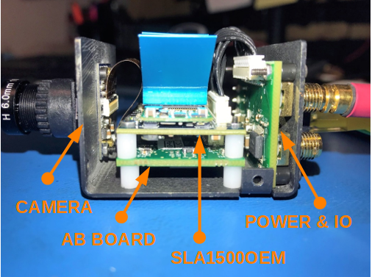
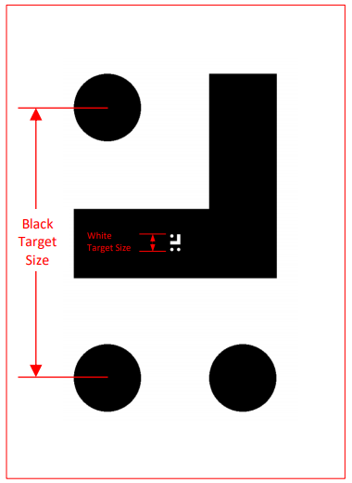
SightLine Applications has developed a precision visual landing aid for UAV's. The Landing Aid supports autonomous landing operations by automatically finding and tracking an easy to place landing pattern.

Slide 3
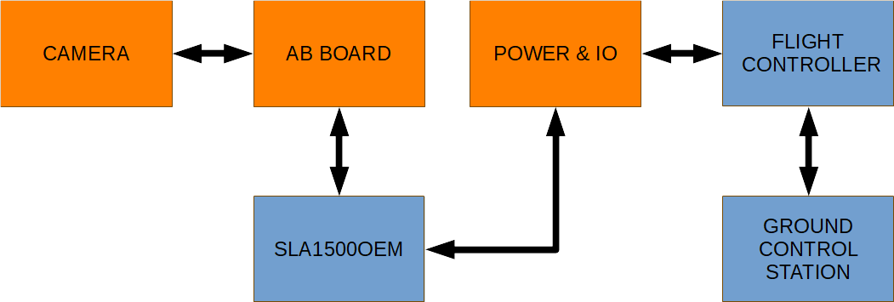

Slide 4
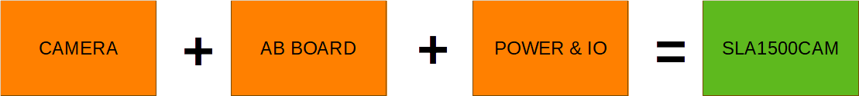

Slide 5
